Slide 1

Credit Default Prediction MGMT 571 Data Mining Project
RAP Miners

Slide 2



RAP Miners Team
Rohan Das
Arpan Datta
Padma Dwivedi

Slide 3






Explore
Default prediction methodology
Data Deep Dive: Analyze patterns and trends
Modify
Pre-process Data: Transform inputs to increase significance
Model
Model Run: Feature selection and Parameter tuning
Assess
Model Selection: Train-Test Score evaluation
Utility
Learning and Future Scope
Notes:
We have used SAS node groups to divide our credit default prediction in five stages

Slide 4
Data Transformation

Slide 5
Data Pre-Processing
No change for pre-standardized variables: Limit and Age
Imbalanced data Default Target
Interval Variables: Best Transformation
Outlier Cap: Interval MAD outliers were capped
3x number of non-defaulters compared to defaulters
Outliers were replaced with their MAD values
Categorical Variable: Dummy variables
Marriage and sex have relatively low significance on default

Slide 6
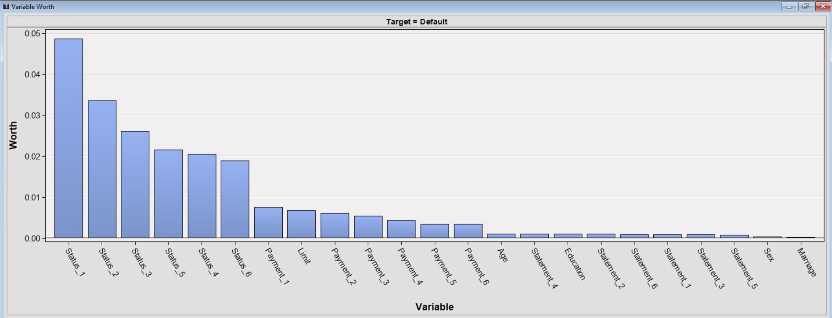
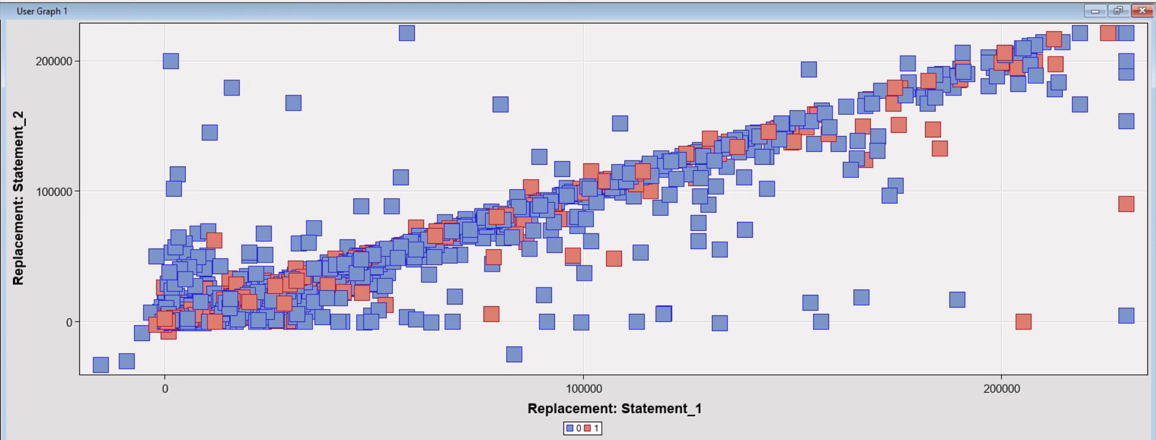
EDA: Insights
Variable Worth for all data
Correlation w.r.t. default
High dependency among time periods

Slide 7
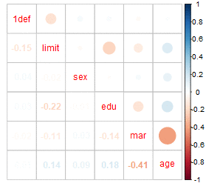
Correlation plots
High corr. With Limits
High Corr. With status
Negligible corr. with Payments made to bank
NO corr. with Bills statements

Slide 8
Model Selection

Slide 9
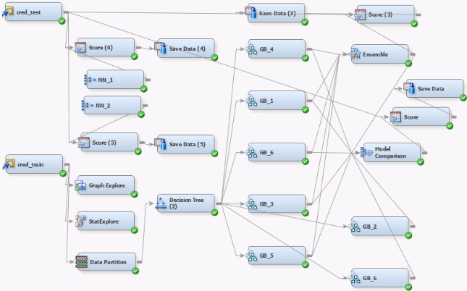
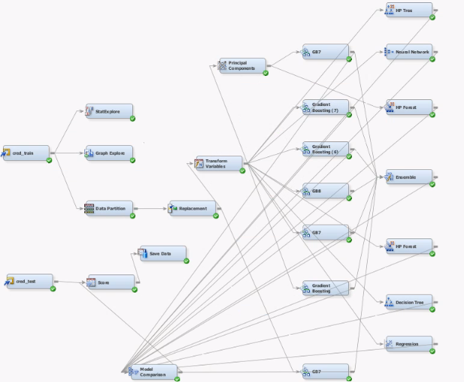

Model Selection
Model Runs: Variable selection and Tuning
Selected criteria:
best performance with train-validation criteria
To address sample bias we stratified the data partition
good public leaderboard score
We ran Few models with dEcision trees as the variable selector node
Notes:
This is the diagram we used to iterate the parameters for the model selection Best results came from : Stratifying data partition and using decision tree as variable selection node

Slide 10
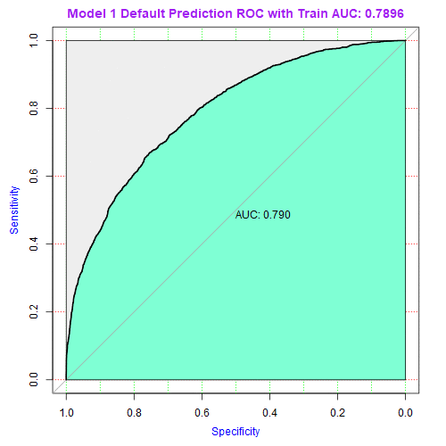
ROC Runs
AUC ranges from 0.692 to 0.790
We selected two models eventually one from leaderbaord and one from the plot with 0.790

Slide 11
Final Prediction

Slide 12
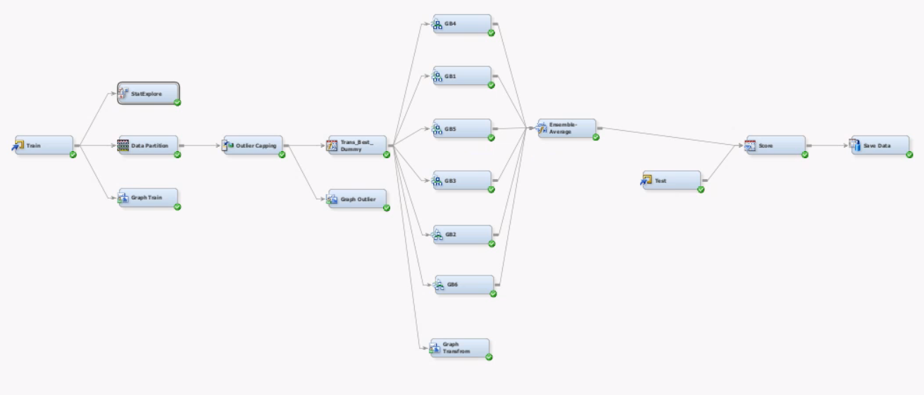
Model & Learning
Final Submitted Model
Data Deep Dive (EDA)
Data pre-Processing
Model Run
Test Prediction
GBM Parameters: #iterations, Shrinkage, leaf fraction & max. depth
LEARNINGS:
More TIME FOR EDA!
Stratification & demog
Time series analysis
Recommendation:
Segmentation USING PREDicted Default score: decrease limits step by step
Notes:
Selected Model was re-run with 100% of Train data

Slide 13
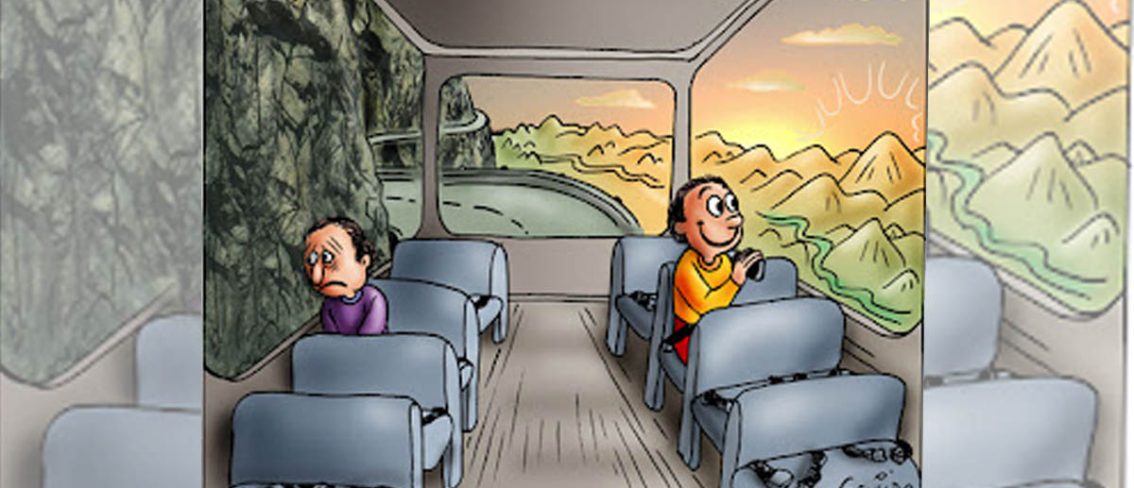
Kaggle Results
Train score
Test score

Slide 14
References
https://www.sas.com/content/dam/SAS/support/en/sas-global-forum-proceedings/2018/1857-2018.pdf
https://medium.com/@vijaya.beeravalli/comparison-of-machine-learning-classification-models-for-credit-card-default-data-c3cf805c9a5a
https://medium.com/swlh/predicting-credit-card-defaults-with-machine-learning-fcc8da2fdafb
https://www.hindawi.com/journals/complexity/2021/6618841/
https://lexjansen.com/nesug/nesug07/sa/sa17.pdf
https://www.kaggle.com/gpreda/hyperparameter-tuning-using-gridsearch-with-h2o
https://rviews.rstudio.com/2019/03/01/some-r-packages-for-roc-curves/
https://knowyourmeme.com/memes/two-guys-on-a-bus
We USED suggestions from multiple ongoing research to learn more about the standards in the industry

Slide 15
Appendix

Slide 16
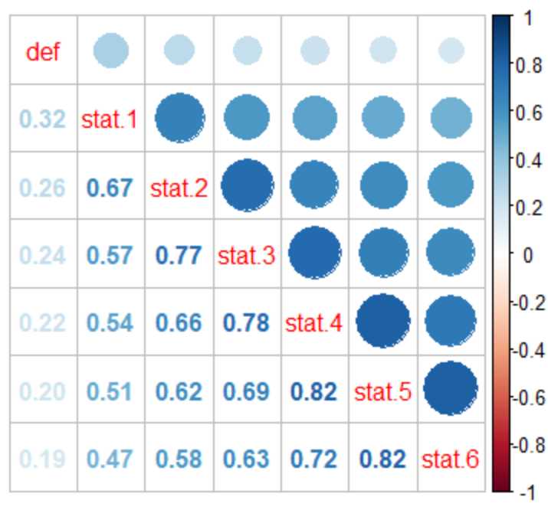
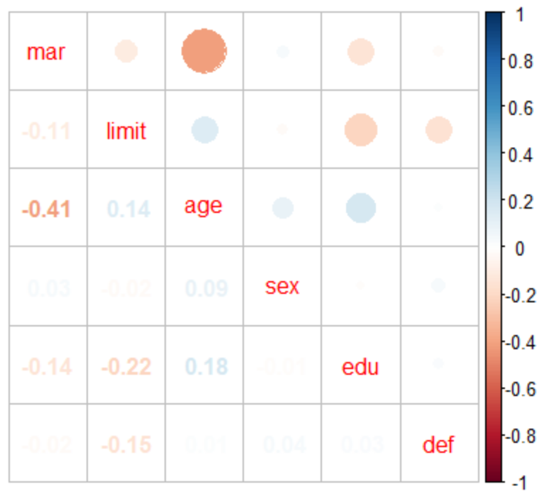
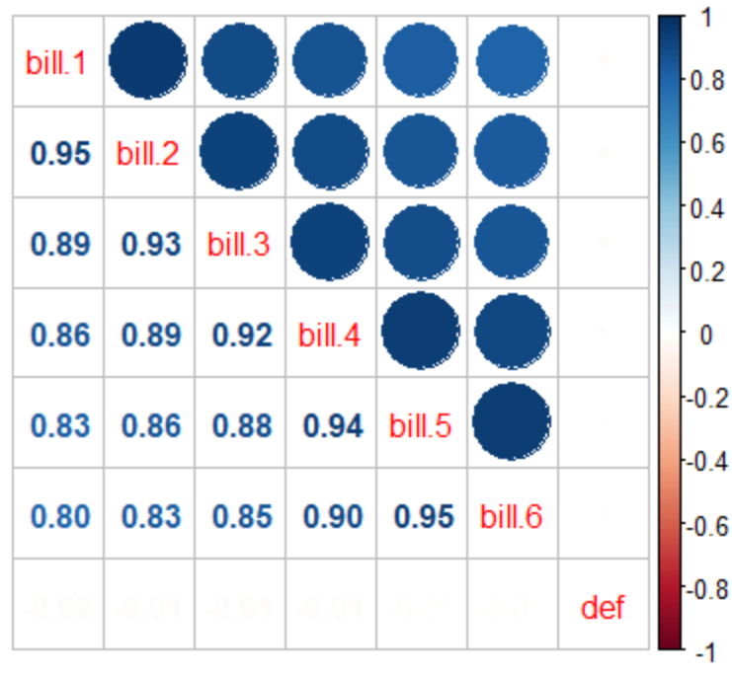
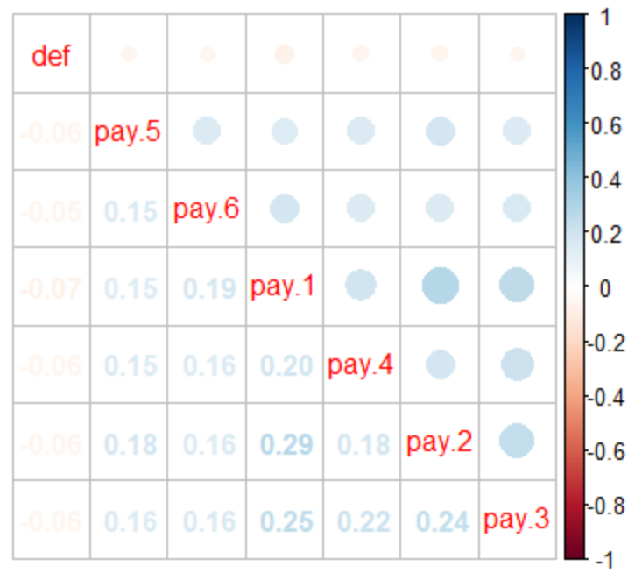
Raw Input Correlation Plots
Correlation Plots with respect to default

Slide 17
EDA:
Deep Dive
There is a linear relationship between Statement_1 and Statement_2.
This indicates the possibility of collinearity between multiple variables.
Thus, selection of a model such as Gradient Boosting or Decision Tree would be preferable over any model based on linear regression

Slide 18
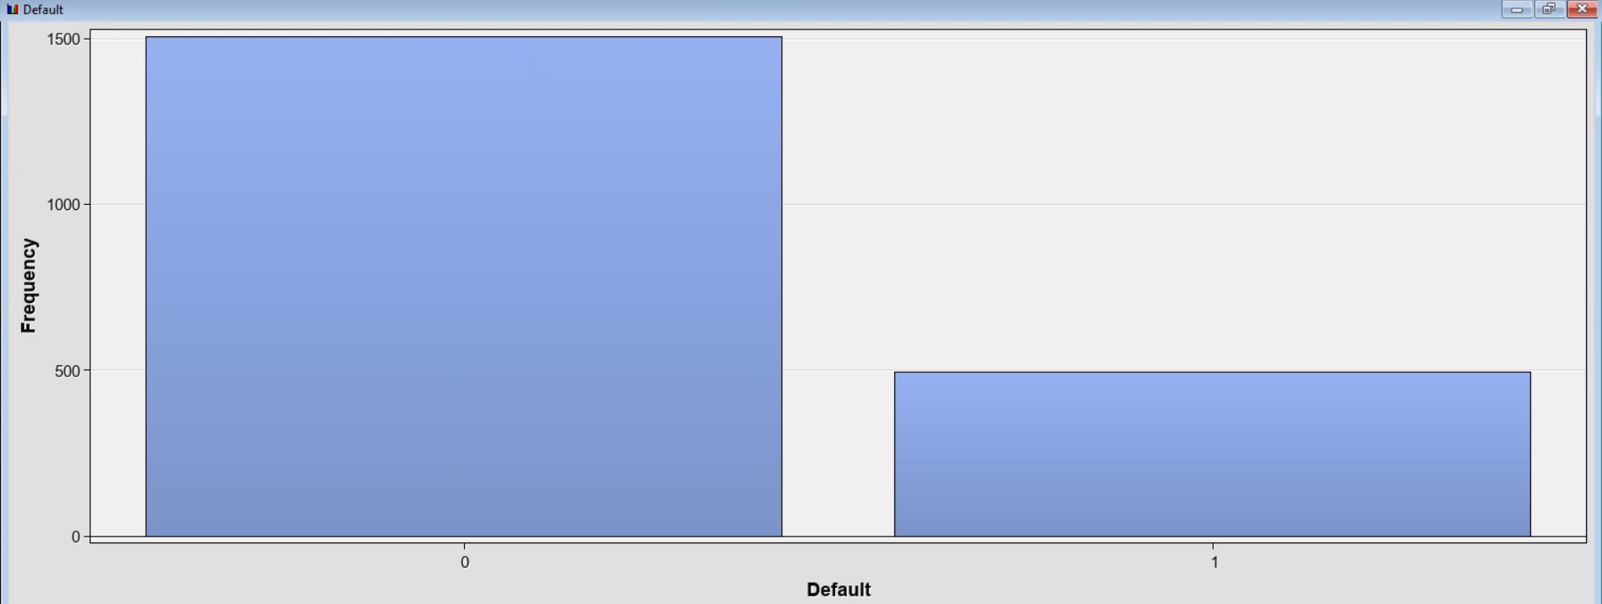
EDA: Target Variable
From the frequency plot we can see that the frequency of default is lower than not defaulting in case of this data

Slide 19
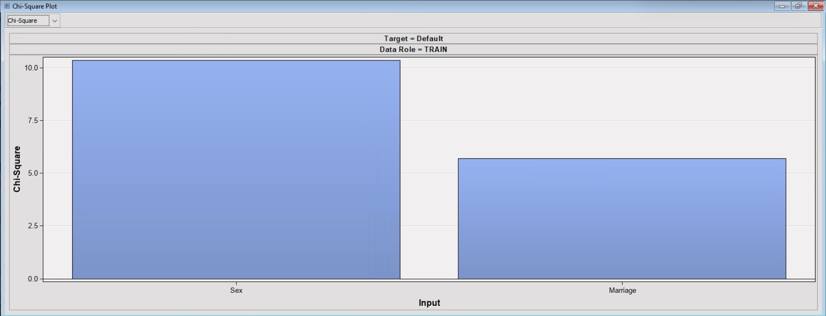
EDA: Categorical Data
Chi Square of sex and marriage can be observed from this plot
This implies that sex has more effect on default than marriage

Slide 20
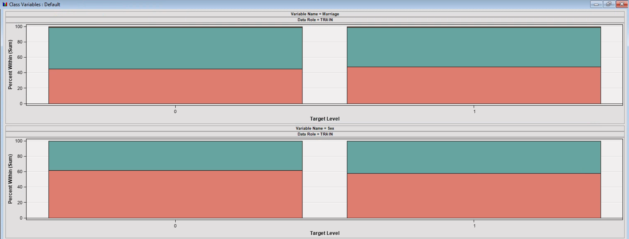
EDA
The variations in marriage with respect to the default doesn’t seem important
Similarly for Gender, indicating that they are not very good predictors to identify whether a card user will defaulT

Slide 21
EDA
Variable worth plot indicating the worth of the variables. Status_1, Status_2 so on till Status_6 have the highest variable worth.

Slide 22
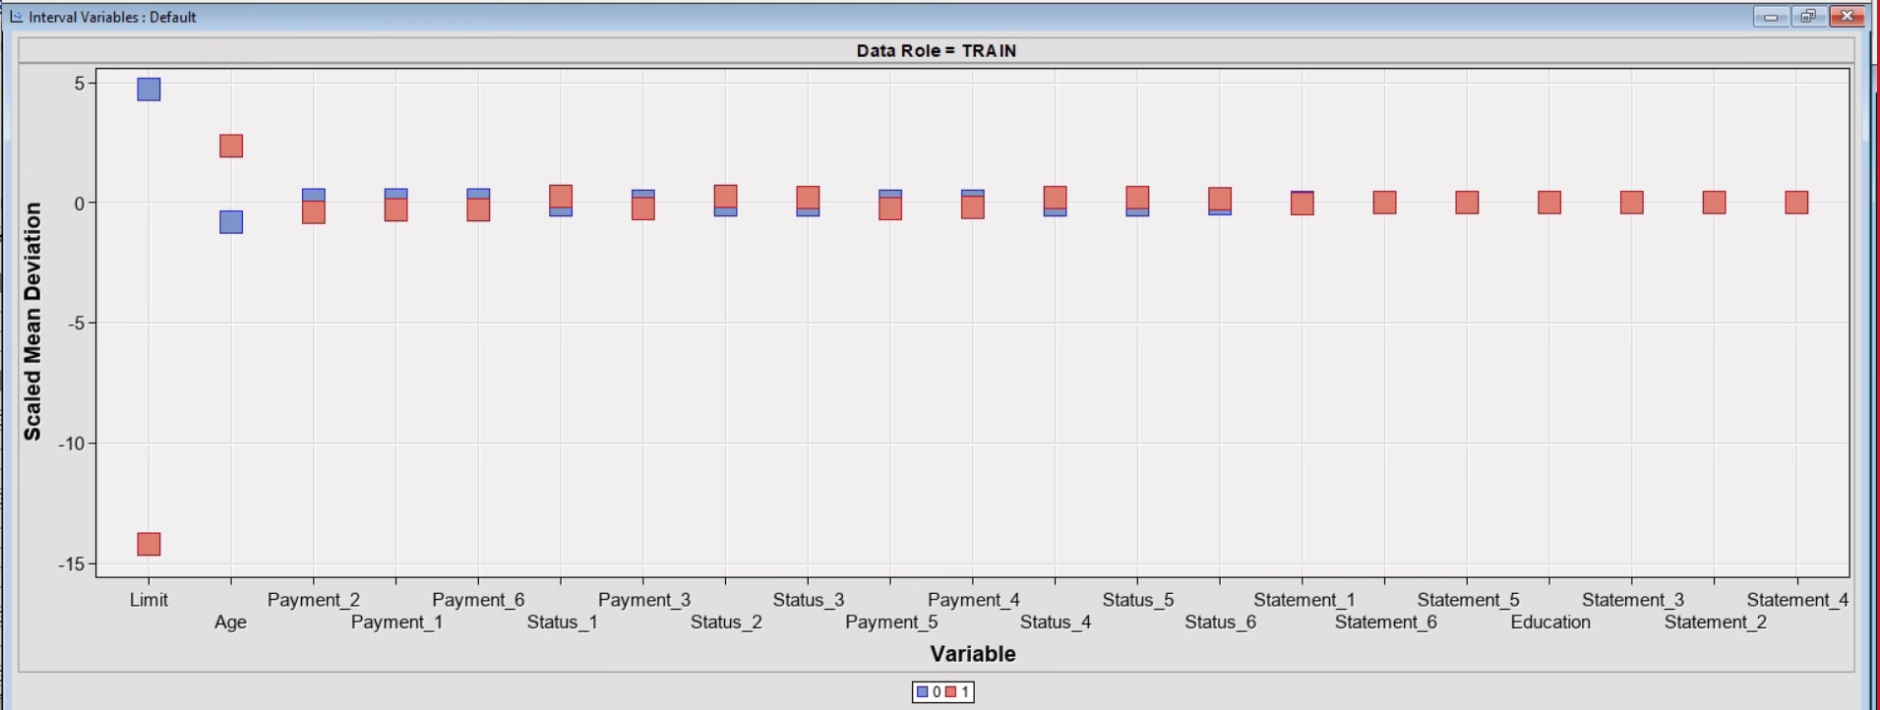
EDA
scaled Mean deviation, it is INFERRED that the variables Limit, and Age can best predict the variation in Default

Slide 23
Thank You!

